Slide 1

Full Gospel Business Australia FGBA
♦ MDN I – GOD & SELF ♦
2017

Slide 2
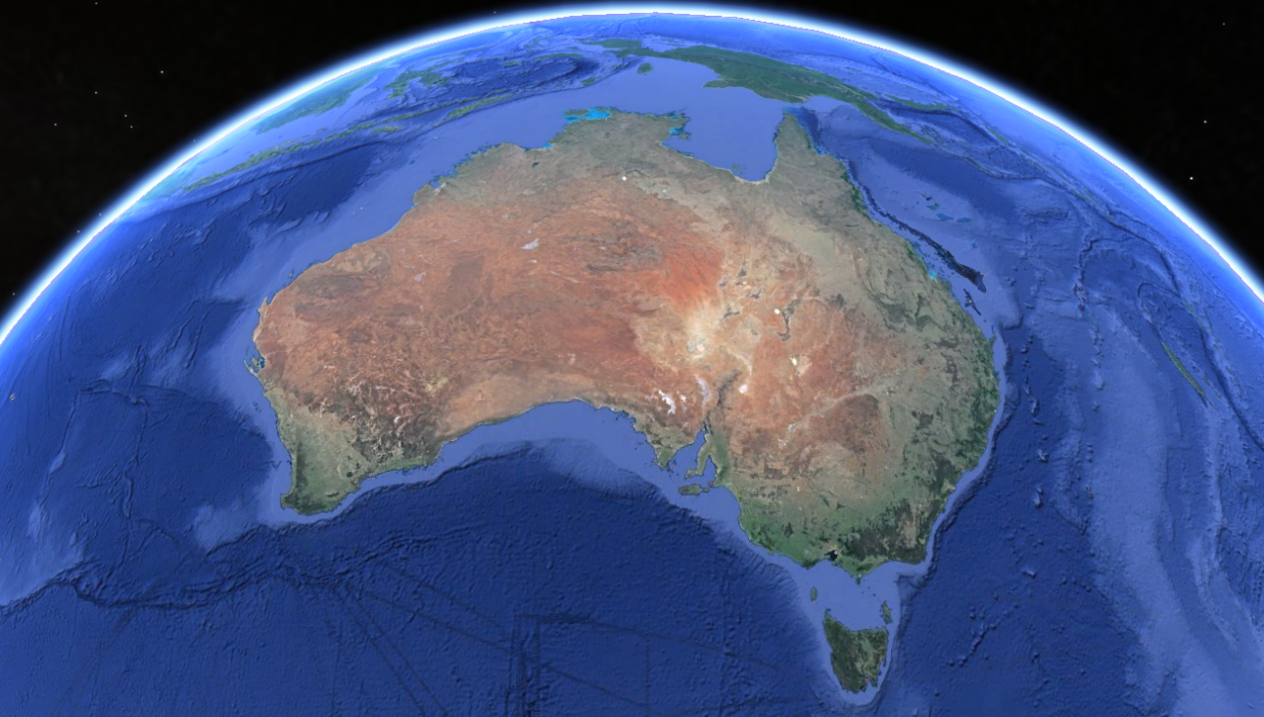
SESSION 2
Take Up!
FGB Australia – MDM - copyright FGB Gatekeepers Singapore

Slide 3
Objectives
To know His Lordship in all the aspects of my life
To deny myself, TAKE UP my cross & follow Jesus daily by ordering my priorities in my life
FGB Australia – MDM - copyright FGB Gatekeepers Singapore

Slide 4
Revelation
What Does The Bible Say?
FGB Australia – MDM - copyright FGB Gatekeepers Singapore

Slide 5
JESUS, OUR SAVIOR & OUR LORD
The word “saviour” is found 36 times in the Bible.
The word “lord” occurs over 7,800 times.
Where do you think God places the emphasis?
Lord declares the position He holds in our lives, whereas Saviour describes the work He’s done for us. We cannot partake of the benefit of His work unless we come under His position as Lord and King!
– John Bevere, You Need More Than A Savior
FGB Australia – MDM - copyright FGB Gatekeepers Singapore

Slide 6
FGB Australia – MDM - copyright FGB Gatekeepers Singapore

Slide 7
IMPARTAtion
What Is The Spirit Saying?
FGB Australia – MDM - copyright FGB Gatekeepers Singapore

Slide 8
JESUS IS THE LORD OF ALL ASPECTS OF MY LIFE OR NOT LORD AT ALL!
When we acknowledge Jesus as the LORD
of all aspects of our lives, we believe
we will see the truth of God’s Word
come alive in all aspects of our lives!
Here are the aspects of our lives
that will be transformed when we
truly acknowledge His Lordship in our lives:
FGB Australia – MDM - copyright FGB Gatekeepers Singapore

Slide 9
JESUS IS LORD OF ALL OR NOT LORD AT ALL!
FGB Australia – MDM - copyright FGB Gatekeepers Singapore

Slide 10
ACTIVAtion
How Does This
Transform My Life?
FGB Australia – MDM - copyright FGB Gatekeepers Singapore

Slide 11
1. Deny Myself: Narrow Gate & Difficult Way
No need to deny yourself on the easy road:
No demands, deeds, dying to self, discipline
No surrender, suffering, sacrifice
No self-examination, repentance, persecution
The narrow gate is discipleship: following Jesus The difficult way is the Sermon on the Mount Make your choice today
How do I shift from a self-directed life
to Spirit-directed life?
FGB Australia – MDM - copyright FGB Gatekeepers Singapore

Slide 12
2. Take Up My Cross: Total Commitment
Know Jesus requires loyalty to Himself greater than loyalty to any human being Mt 10:37-39; Lk 14:26, 27
Understand Discipleship means submitting our own interests in favour of God’s Phi 3:7-10
Recognise Jesus’ mandate is to “go and make disciples of all nations” Mt 28:19-20
Remember God will test all our relationships to prove that following Jesus is our 1st priority
Is Jesus at the centre of my life in all these areas?
Tick (P) all the areas where Jesus is LORD in your life
FGB Australia – MDM - copyright FGB Gatekeepers Singapore

Slide 13
FGB Australia – MDM - copyright FGB Gatekeepers Singapore

Slide 14
3. Follow Him! Obey His Teachings
Following Jesus is not defined by law, rituals or good work, it is defined by the Person of Christ, who is righteousness, our Savior, Lord & Master. Discipleship is about becoming more & more like Christ & less & less our former selves –following His mandates, pressing into my high calling according to His will.
What are His teachings
that I need to obey & follow?
FGB Australia – MDM - copyright FGB Gatekeepers Singapore

