Slide 1

Full Gospel Business Australia FGBA
♦ MDN I – GOD & SELF ♦
2017

Slide 2
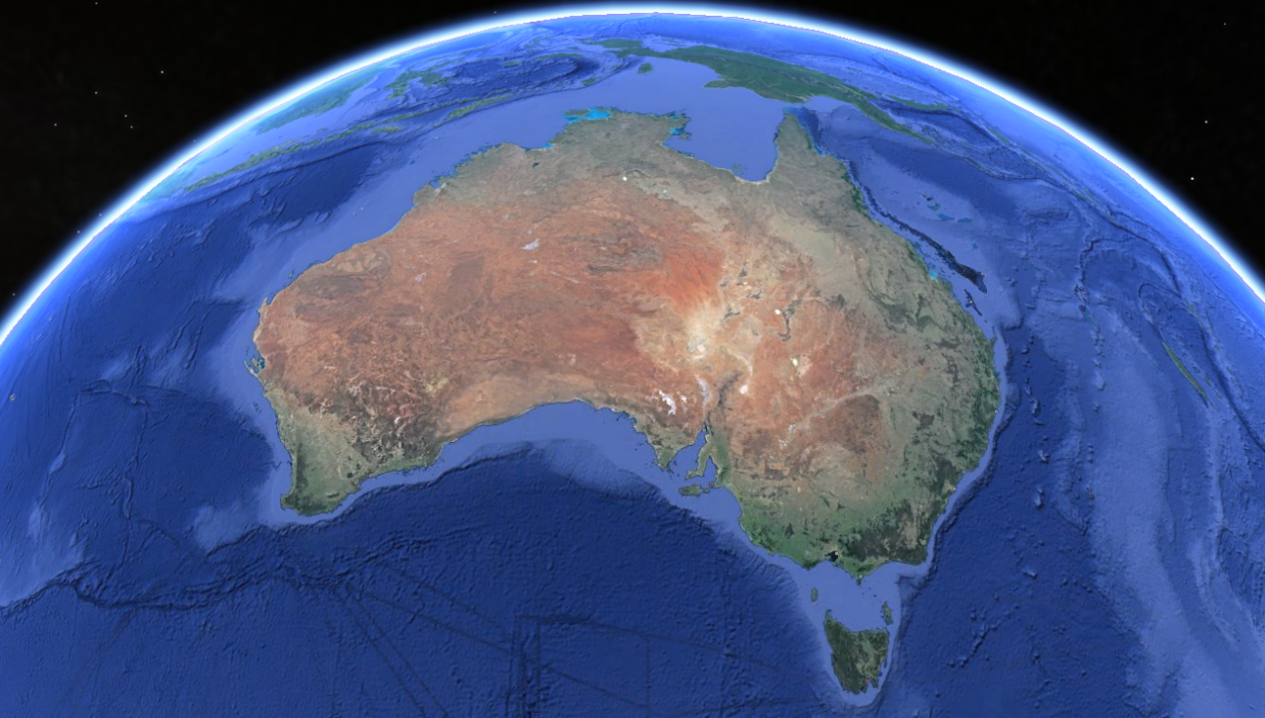
SESSION 5
Seal Up!
FGB Australia – MDM - copyright FGB Gatekeepers Singapore

Slide 3
Objectives
To be made whole & SEAL UP in spirit, soul & body
To die to conform, reform to live to transform
FGB Australia – MDM - copyright FGB Gatekeepers Singapore

Slide 4
Revelation
What Does The Bible Say?
FGB Australia – MDM - copyright FGB Gatekeepers Singapore

Slide 5
THE OLD TEMPLE & THE NEW TEMPLE
Old Temple: For God to dwell amongst His people
New Temple: We are the temple of the Holy Spirit
1 Cor 3:16-17 Do you not know that you are the temple of God and that the Spirit of God dwells in you? If anyone defiles the temple of God, God will destroy him. For the temple of God is holy, which temple you are.
1 Pet 2:5 You also, as living stones, are being built up a spiritual house, a holy priesthood, to offer up spiritual sacrifices acceptable to God through Jesus Christ.
FGB Australia – MDM - copyright FGB Gatekeepers Singapore

Slide 6
1) Spirit Connects Us To The Spiritual Realm
The body without the spirit is dead Jas 2:26
Angels: soul & spirit but no body unless they appear in bodily form)
Animals: body & soul without spirit
FGB Australia – MDM - copyright FGB Gatekeepers Singapore

Slide 7
2) Soul Connects The Spirit Realm To The Natural Realm
Heb 4:12 For the word of God is living and powerful, and sharper than any two-edged sword, piercing even to the division of soul and spirit, and of joints and marrow, and is a discerner of the thoughts and intents of the heart.
3) Body Operates On Five Senses & Connects Us To The Natural Man
Executive of the personality can be spirit, soul or body directed. When we are cut off from God (via the spirit), we will be ruled by our soul & body instead. Rm 8:5-12
FGB Australia – MDM - copyright FGB Gatekeepers Singapore

Slide 8
3) Body Operates On Five Senses & Connects Us To The Natural Man
Executive of the personality can be spirit, soul or body directed. When we are cut off from God (via the spirit), we will be ruled by our soul & body instead. Rm 8:5-12
The Holy Spirit Himself bears witness with our spirit that we are the children of God Rm 8:16 We are connected with the Lord through our spirit 1 Cor 6:17
For transformation to take place, our soul (mind) needs to be renewed even though our spirit is made new! Rm 12:2
We are transformed from glory to glory, just as by the Spirit of the Lord 2 Cor 3:18
Spirit-led, Spirit-controlled life. Flesh gives birth to fleshy lusts, but the Spirit gives birth to spirit life Rm 8:14-15
FGB Australia – MDM - copyright FGB Gatekeepers Singapore

Slide 9
IMPARTAtion
What Is The Spirit Saying?
FGB Australia – MDM - copyright FGB Gatekeepers Singapore

Slide 10
FGB Australia – MDM - copyright FGB Gatekeepers Singapore

Slide 11
ACTIVAtion
How Does This
Transform My Life?
FGB Australia – MDM - copyright FGB Gatekeepers Singapore

Slide 12
PRESS IN, PUT ON, PRESS ON
1) Body: Food, Senses, Reproduction
1 Cor 6:19 Or do you not know that your body is the temple of the Holy Spirit who is in you, whom you have from God, and you are not your own?
What will I do to strengthen my body?
FGB Australia – MDM - copyright FGB Gatekeepers Singapore

Slide 13
PRESS IN, PUT ON, PRESS ON
2) Soul: Mind, Will & Emotions
Meditate on these things: noble, just, pure, lovely, good report, virtue, praiseworthy Phil 4:8
Put off the old man, renew the spirit of your mind Eph 4:17-25
What must I do to submit my soul under the direction of the Holy Spirit?
FGB Australia – MDM - copyright FGB Gatekeepers Singapore

Slide 14
PRESS IN, PUT ON, PRESS ON
3) Spirit: Intuition, Conscience
Strengthen your intuition by learning to be sensitive to the voice of God Ps 51:10-12
Clean up the conscience through meditating on the word of God Ps 119:9-11
Strengthen your spirit man by spending time in worship & prayer Jude 20-21
How can I strengthen my spirit man?
FGB Australia – MDM - copyright FGB Gatekeepers Singapore

Slide 15
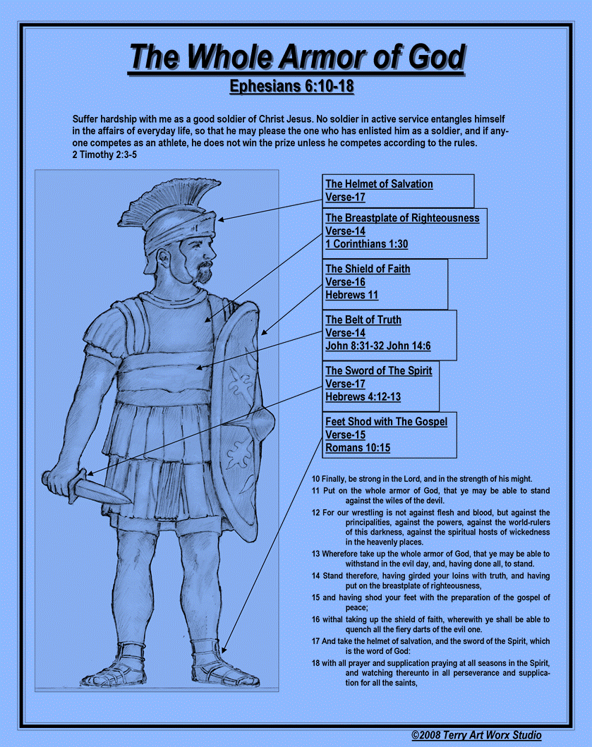
FGB Australia – MDM - copyright FGB Gatekeepers Singapore

